Slide 1
Investigating Atoms and Atomic Theory
Students should be able to:
Describe the particle theory of matter. PS.2a
Use the Bohr model to differentiate among the three basic particles in the atom (proton, neutron, and electron) and their charges, relative masses, and locations. PS.3
Compare the Bohr atomic model to the electron cloud model with respect to their ability to represent accurately the structure of the atom.PS.3

Slide 2
Atomos: Not to Be Cut
The History of Atomic Theory

Slide 3
Atomic Models
This model of the atom may look familiar to you. This is the Bohr model. In this model, the nucleus is orbited by electrons, which are in different energy levels.
A model uses familiar ideas to explain unfamiliar facts observed in nature.
A model can be changed as new information is collected.

Slide 4
The atomic model has changed throughout the centuries, starting in 400 BC, when it looked like a billiard ball →

Slide 5
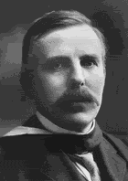
Who are these men?
In this lesson, we’ll learn about the men whose quests for knowledge about the fundamental nature of the universe helped define our views.

Slide 6
Democritus
400 BC
This is the Greek philosopher Democritus who began the search for a description of matter more than 2400 years ago.
He asked: Could matter be divided into smaller and smaller pieces forever, or was there a limit to the number of times a piece of matter could be divided?

Slide 7
Atomos
His theory: Matter could not be divided into smaller and smaller pieces forever, eventually the smallest possible piece would be obtained.
This piece would be indivisible.
He named the smallest piece of matter “atomos,” meaning “not to be cut.”

Slide 8
Atomos
To Democritus, atoms were small, hard particles that were all made of the same material but were different shapes and sizes.
Atoms were infinite in number, always moving and capable of joining together.

Slide 9
This theory was ignored and forgotten for more than 2000 years!

Slide 10
Why?
The eminent philosophers of the time, Aristotle and Plato, had a more respected, (and ultimately wrong) theory.
Aristotle and Plato favored the earth, fire, air and water approach to the nature of matter. Their ideas held sway because of their eminence as philosophers. The atomos idea was buried for approximately 2000 years.

Slide 11
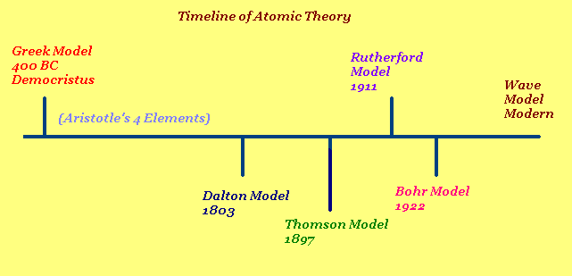

Slide 12
Dalton’s Model
In the early 1800s, the English Chemist John Dalton performed a number of experiments that eventually led to the acceptance of the idea of atoms.

Slide 13
Dalton’s Theory
He deduced that all elements are composed of atoms. Atoms are indivisible and indestructible particles.
Atoms of the same element are exactly alike.
Atoms of different elements are different.
Compounds are formed by the joining of atoms of two or more elements.

Slide 14
.
This theory became one of the foundations of modern chemistry.

Slide 15
Thomson’s Plum Pudding Model
In 1897, the English scientist J.J. Thomson provided the first hint that an atom is made of even smaller particles.

Slide 16
Thomson Model
He proposed a model of the atom that is sometimes called the “Plum Pudding” model.
Atoms were made from a positively charged substance with negatively charged electrons scattered about, like raisins in a pudding.

Slide 17
Thomson Model
Thomson studied the passage of an electric current through a gas.
As the current passed through the gas, it gave off rays of negatively charged particles.

Slide 18
Thomson Model
Where did they come from?
This surprised Thomson, because the atoms of the gas were uncharged. Where had the negative charges come from?

Slide 19
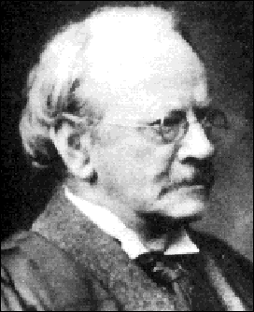
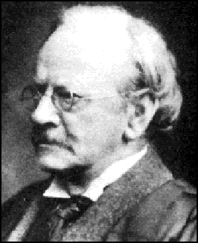
Thomson concluded that the negative charges came from within the atom.
A particle smaller than an atom had to exist.
The atom was divisible!
Thomson called the negatively charged “corpuscles,” today known as electrons.
Since the gas was known to be neutral, having no charge, he reasoned that there must be positively charged particles in the atom.
But he could never find them.

Slide 20
Rutherford’s Gold Foil Experiment
In 1908, the English physicist Ernest Rutherford was hard at work on an experiment that seemed to have little to do with unraveling the mysteries of the atomic structure.

Slide 21
Rutherford’s experiment Involved firing a stream of tiny positively charged particles at a thin sheet of gold foil (2000 atoms thick)

Slide 22
Most of the positively charged “bullets” passed right through the gold atoms in the sheet of gold foil without changing course at all.
Some of the positively charged “bullets,” however, did bounce away from the gold sheet as if they had hit something solid. He knew that positive charges repel positive charges.

Slide 24
http://chemmovies.unl.edu/ChemAnime/RUTHERFD/RUTHERFD.html
http://chemmovies.unl.edu/ChemAnime/RUTHERFD/RUTHERFD.html

Slide 25
This could only mean that the gold atoms in the sheet were mostly open space. Atoms were not a pudding filled with a positively charged material.
Rutherford concluded that an atom had a small, dense, positively charged center that repelled his positively charged “bullets.”
He called the center of the atom the “nucleus”
The nucleus is tiny compared to the atom as a whole.

Slide 26
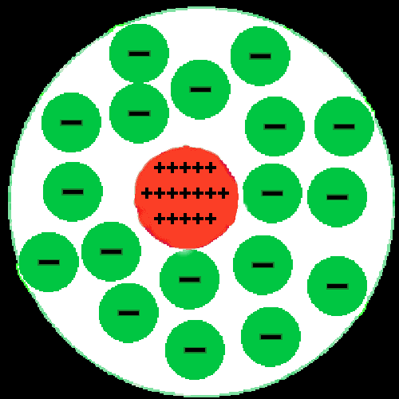
Rutherford
Rutherford reasoned that all of an atom’s positively charged particles were contained in the nucleus. The negatively charged particles were scattered outside the nucleus around the atom’s edge.

Slide 27
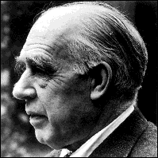
Bohr Model
In 1913, the Danish scientist Niels Bohr proposed an improvement. In his model, he placed each electron in a specific energy level.

Slide 28
Bohr Model
According to Bohr’s atomic model, electrons move in definite orbits around the nucleus, much like planets circle the sun. These orbits, or energy levels, are located at certain distances from the nucleus.

Slide 29
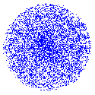
Wave Model

Slide 30
The Wave Model
Today’s atomic model is based on the principles of wave mechanics.
According to the theory of wave mechanics, electrons do not move about an atom in a definite path, like the planets around the sun.

Slide 31
The Wave Model
In fact, it is impossible to determine the exact location of an electron. The probable location of an electron is based on how much energy the electron has.
According to the modern atomic model, at atom has a small positively charged nucleus surrounded by a large region in which there are enough electrons to make an atom neutral.

Slide 32
Electron Cloud:
A space in which electrons are likely to be found.
Electrons whirl about the nucleus billions of times in one second
They are not moving around in random patterns.
Location of electrons depends upon how much energy the electron has.

Slide 33
Electron Cloud:
Depending on their energy they are locked into a certain area in the cloud.
Electrons with the lowest energy are found in the energy level closest to the nucleus
Electrons with the highest energy are found in the outermost energy levels, farther from the nucleus.

Slide 34
 | Indivisible | Electron | Nucleus | Orbit | Electron Cloud
Greek | X
Dalton | X
Thomson |  | X
Rutherford |  | X | X
Bohr |  | X | X | X
Wave |  | X | X |  | X

