Slide 1
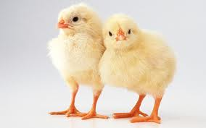
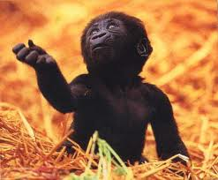
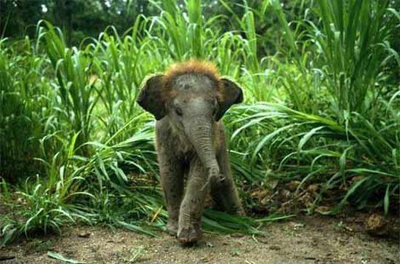
Animals and their babies
EQ: How can I match an animal parent to its baby using a physical description as an explanation.
SKL2. Students will compare the similarities and differences in groups of organisms.
d. Match pictures of animal parents and their offspring explaining your reasoning

Slide 2
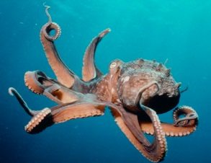
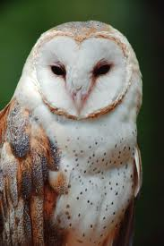
Who is the parent? Tell how you know?

Slide 3
Did you pick the owl?
Sometimes animal babies don’t look like their parents right away. They must grow to resemble their parents. You can still look for similar features such as a beak, large eyes and two legs.

Slide 4
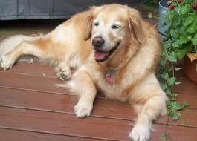
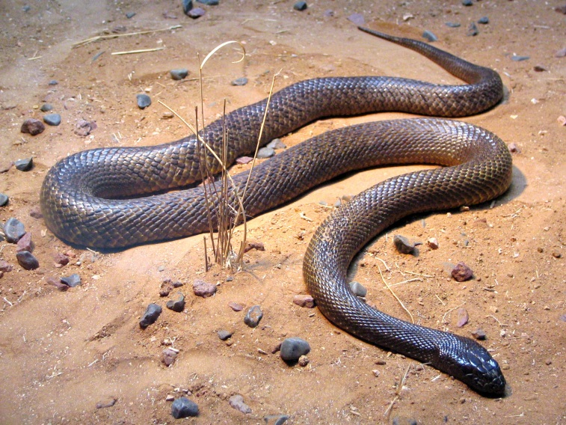
Who is the parent? Tell a friend how you know.

Slide 5
Did you pick the dog? Why?

Slide 6
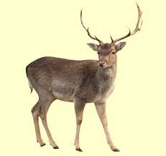
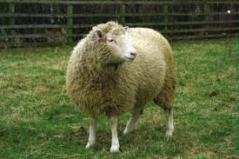
Who is the parent? Think of two different ways you know.

Slide 7
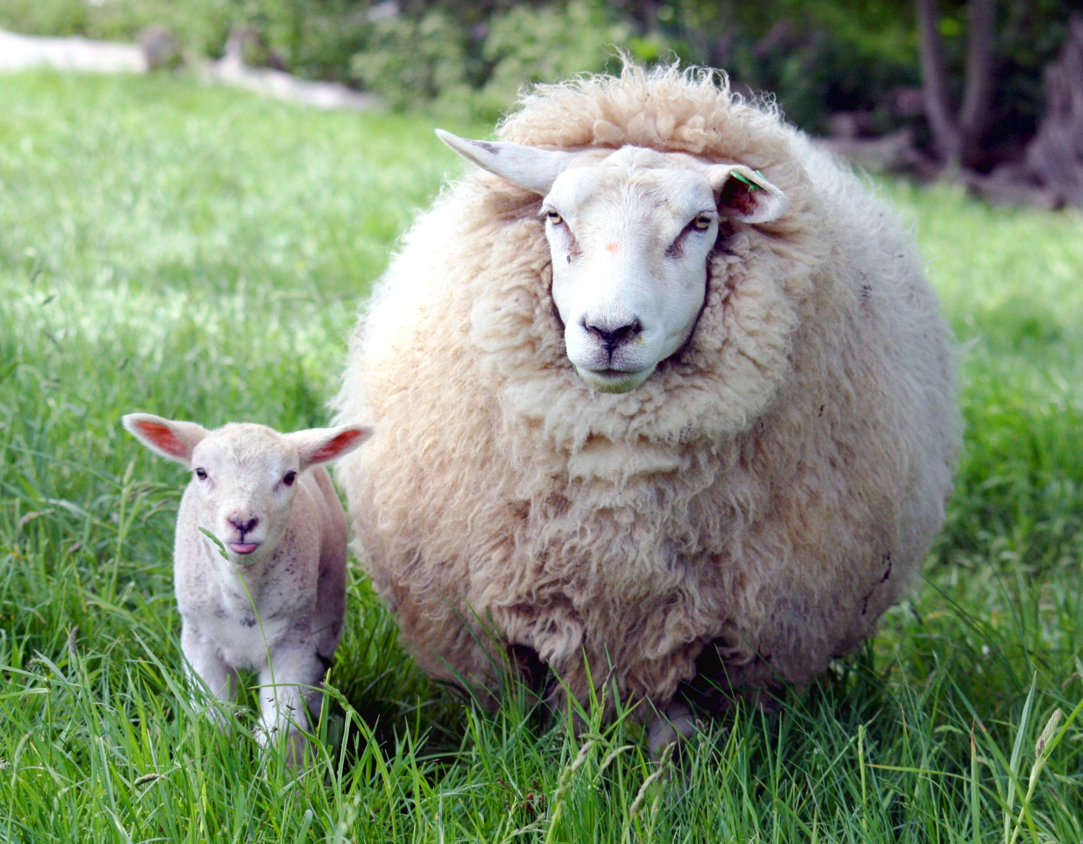
The lamb belongs to the sheep!

Slide 8
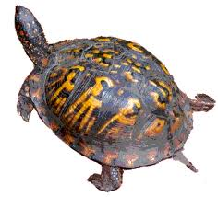
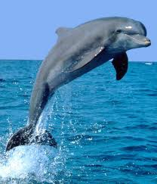
Who is the parent? Describe it.

Slide 9
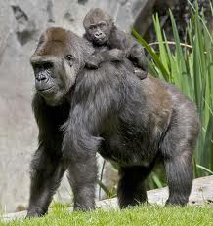
Name the animal
Gorilla

Slide 10
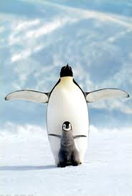
Penguin

Slide 11
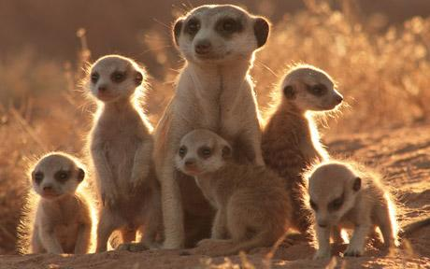
meerkat

Slide 12
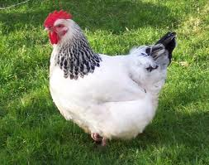
chicken

Slide 13
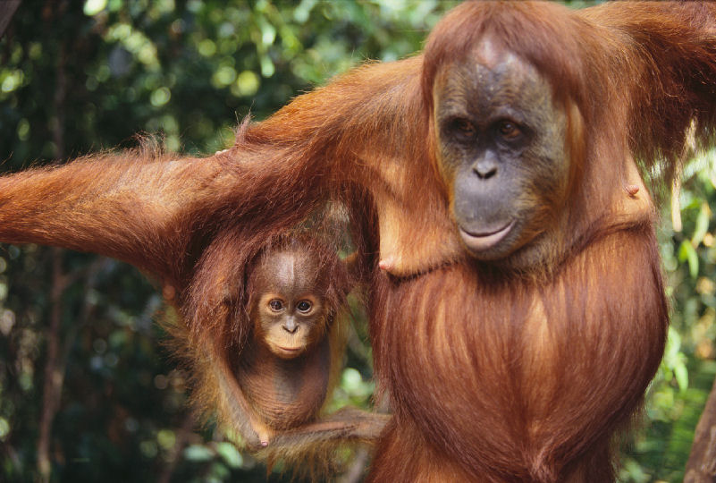
orangutan

Slide 14
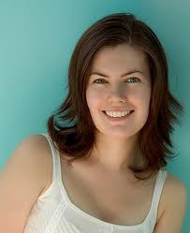
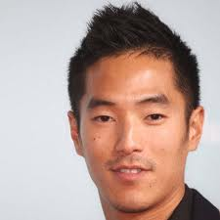
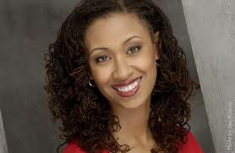
You are an animal too! A human animal.

